Slide 1






Towards Robust Local Key Estimation
with a Musically Inspired Neural Network
Yiwei Ding and Christof Weiß
Computational Humanities
Center for Artificial Intelligence and Data Science, Universität Würzburg
yiwei.ding@uni-wuerzburg.de
Notes:
(potentially) self-intro, explain robustness and musically inspired contributions

Slide 2
Introduction
Local key
Notes:
Add name and title in the foot
Explain the keys, add audio examples

Slide 3
Introduction
Local key
Composition
Perception
Notes:
Add name and title in the foot
Explain the keys, add audio examples

Slide 4
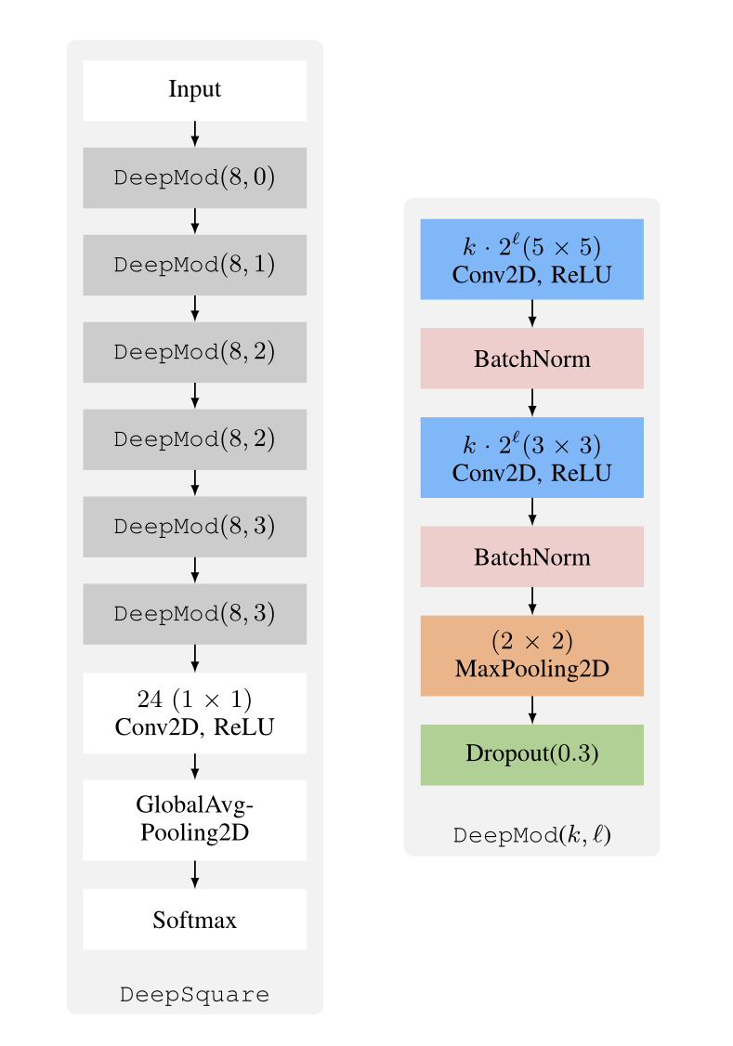
Related Work
Local Key Estimation
HMM-based
CNN-based
Robustness
Versions
Songs
Weiß et. al., ”Local Key Estimation in Music Recordings: A Case Study Across Songs, Versions and Annotators”, IEEE/ACM TASLP, 2020.
Notes:
Intro of related work: LKE (classical methods, ambiguity, robustness etc.) + DL methods (LKE paper)

Slide 5
Dataset
Schubert Winterreise
Cross-version dataset
24 songs * 9 versions

Slide 6
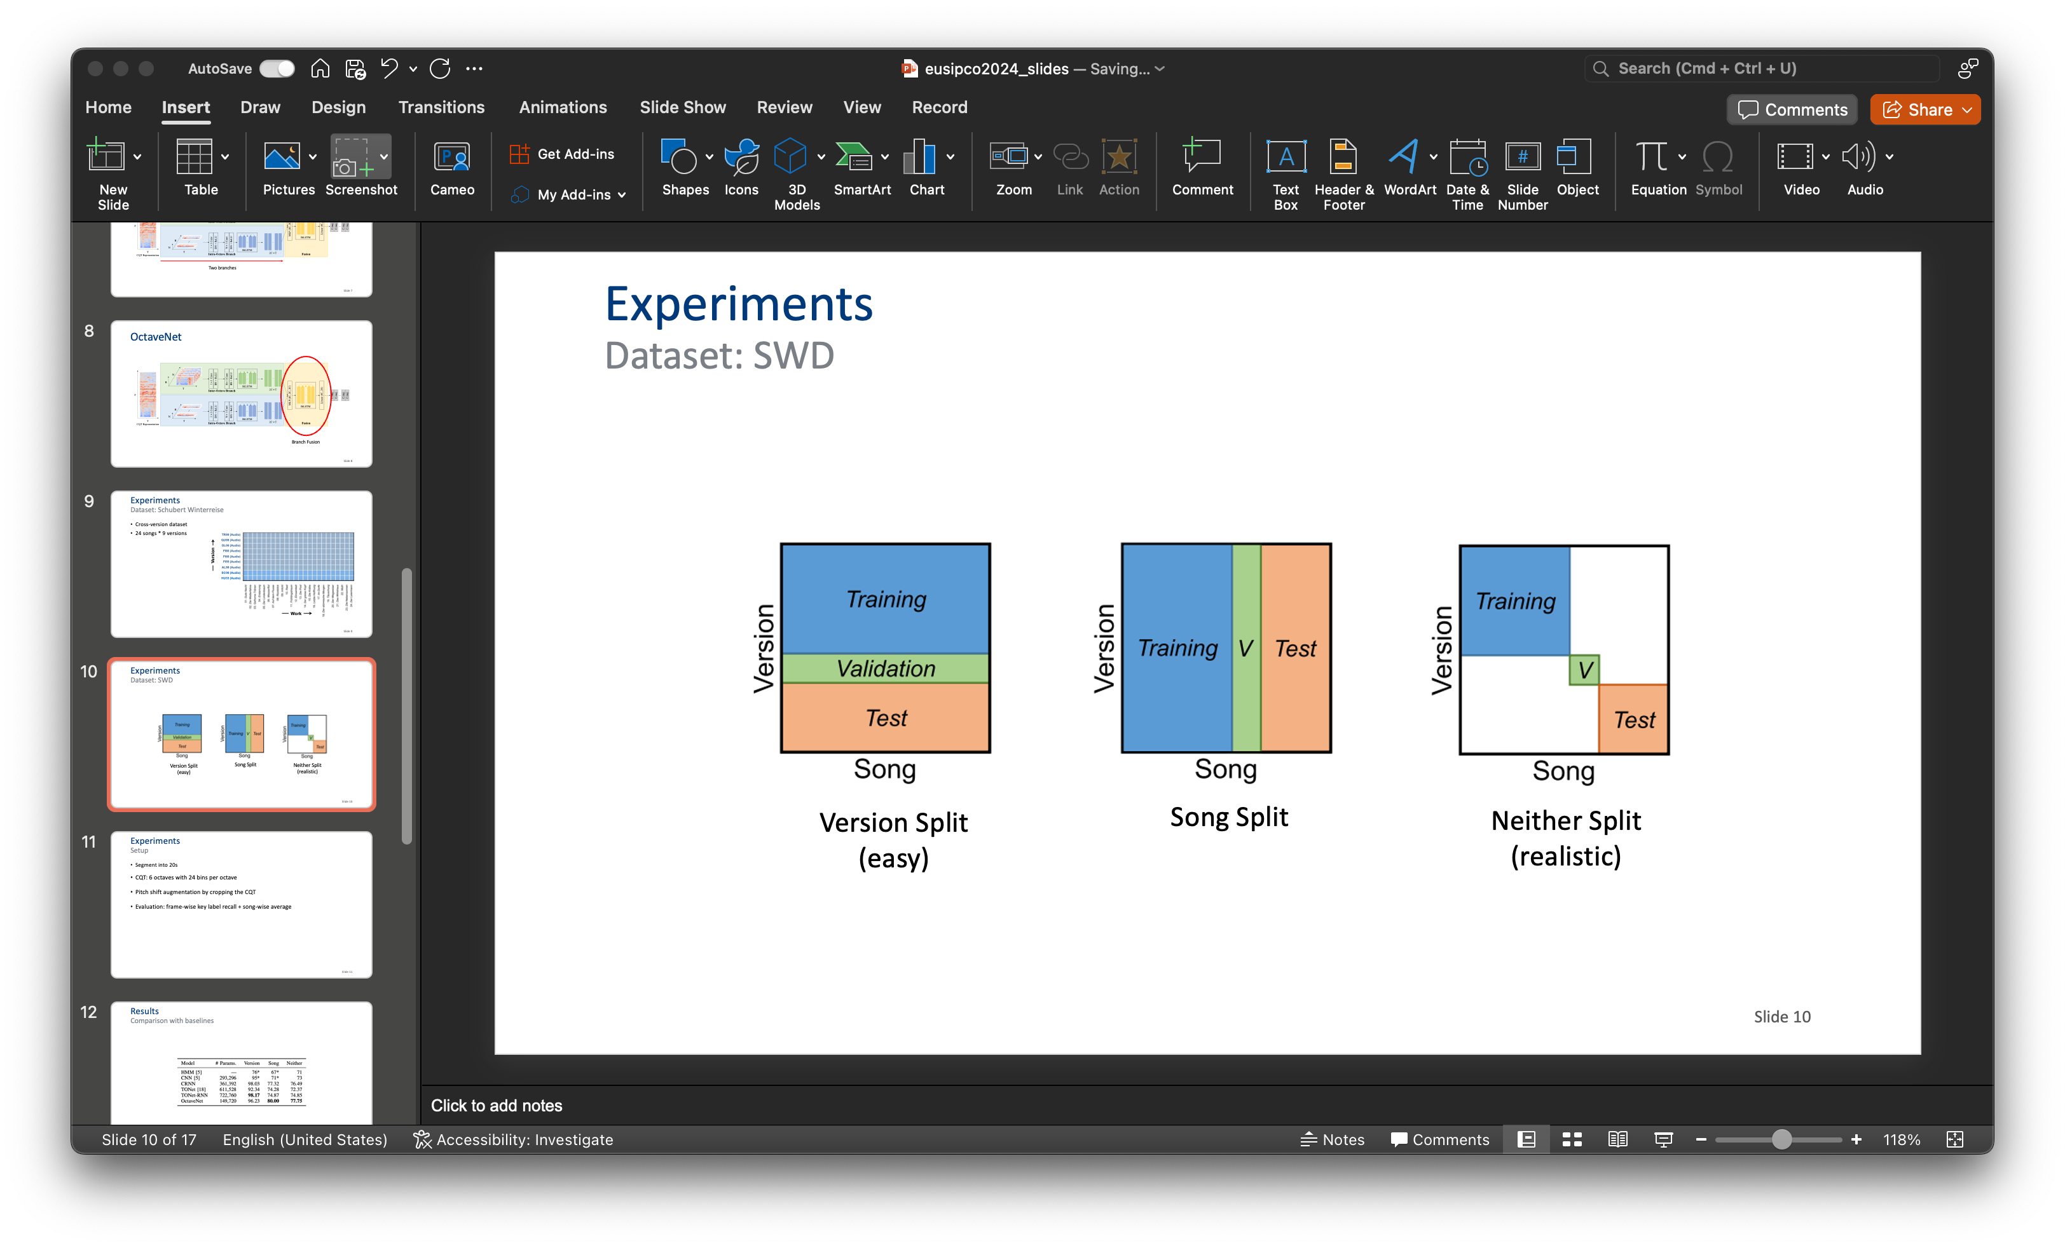
Dataset
Data splits
Version Split
(easy)
Song Split
Neither Split
(realistic)
~59% data unused!
Notes:
Refer to previous work

Slide 7
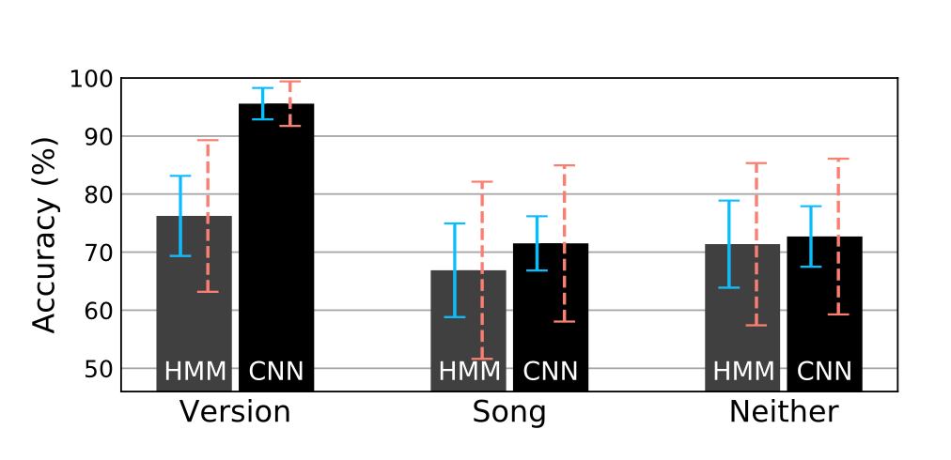
Related Work
Local Key Estimation
CNN outperforms HMM on all splits
Generalization to unseen versions is easier
Notes:
Refer to previous work

Slide 8
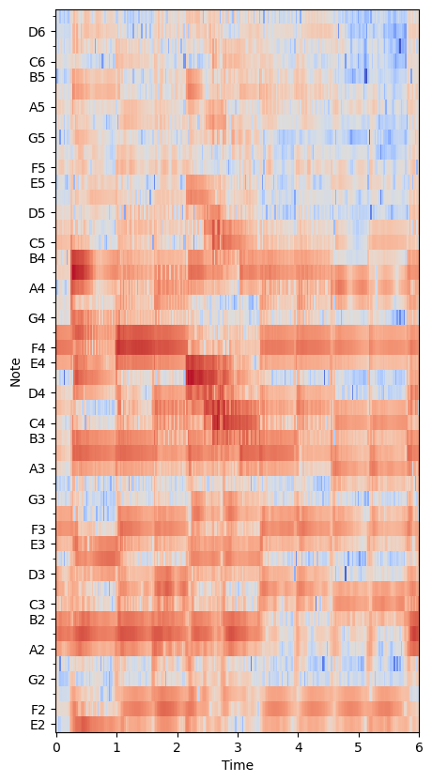
Proposed Method
OctaveNet
A4
Far away!
A3
CQT Representation
Notes:
Another structure: Intro-dataset-refer to previous results-octavenet-our results

Slide 9
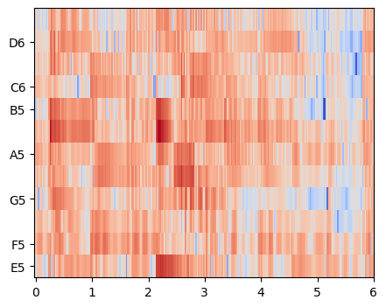
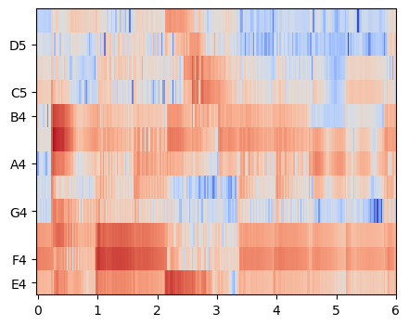
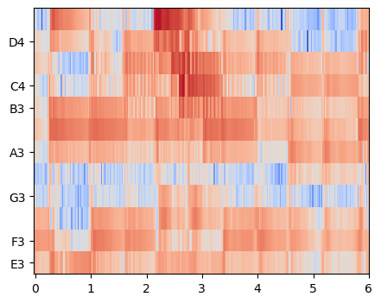
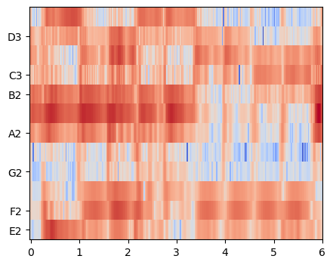
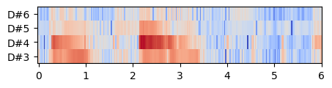
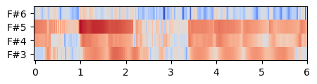
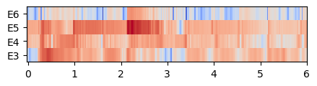
Proposed Method
OctaveNet
…
CQT Rearrangement
Notes:
Maybe too fast -> Remake the figures with labels

Slide 10
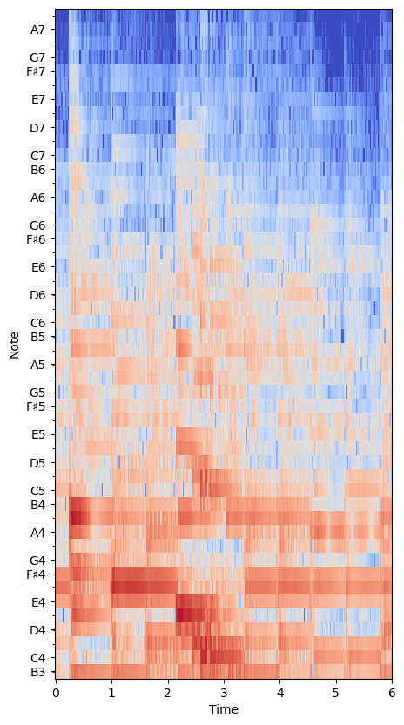
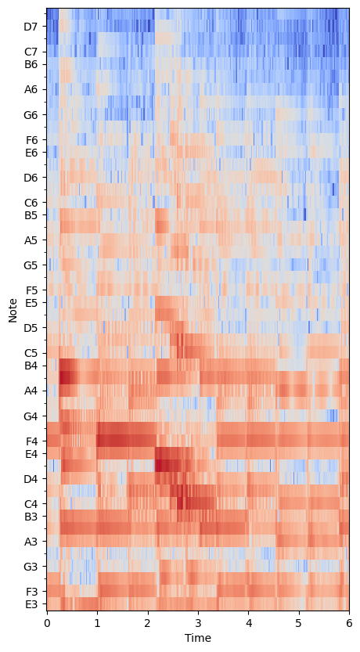
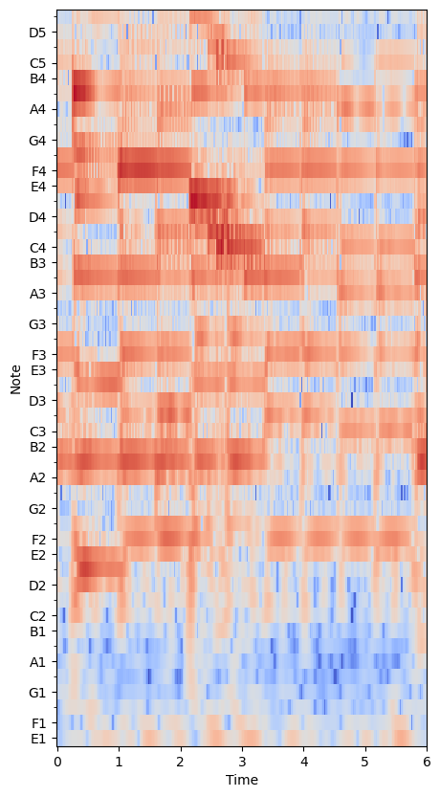
Proposed Method
OctaveNet vs HCQT
…
HCQT
OctaveNet
Bittner et. al., ”Deep Salience Representations for F0 Estimation In Polyphonic Music”, in ISMIR, 2017.
Notes:
Maybe too fast -> Remake the figures with labels

Slide 11
Proposed Method
OctaveNet vs HCQT
Harmonics-based / Octave-based
Multiple CQT / Single CQT
Full-resolution / Low resolution
…
OctaveNet
HCQT
Bittner et. al., ”Deep Salience Representations for F0 Estimation In Polyphonic Music”, in ISMIR, 2017.
Notes:
Maybe too fast -> Remake the figures with labels

Slide 12
Proposed Method
OctaveNet
Notes:
Explain convolution -> see whole octave/

Slide 13
Proposed Method
OctaveNet
…

Slide 14
Proposed Method
OctaveNet
BiLSTM
MLP (4C, 2C, 2C)
...
Linear (4C, 24)
…
Branch Fusion

Slide 15
Proposed Method
OctaveNet

Slide 16
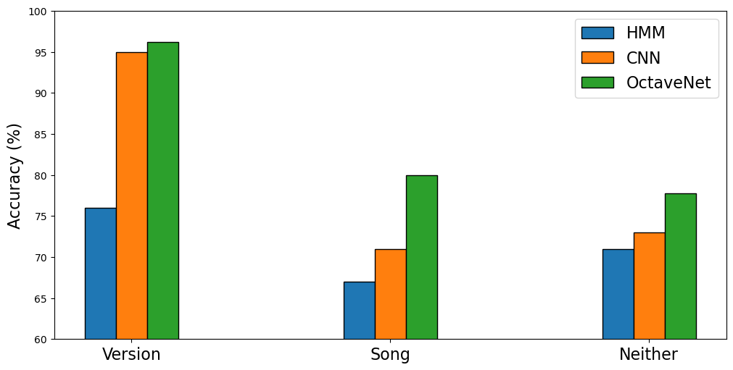
Results
Comparison with baselines
OctaveNet outperforms the baselines on all splits

Slide 17
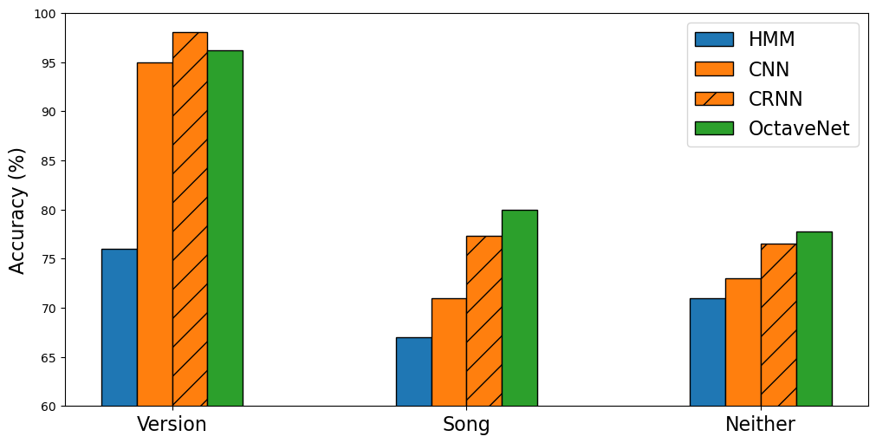
Results
Ablation studies
CRNN performs better than CNN -> Recurrent structure is useful
OctaveNet outperforms CRNN -> CQT rearrangement is useful

Slide 18
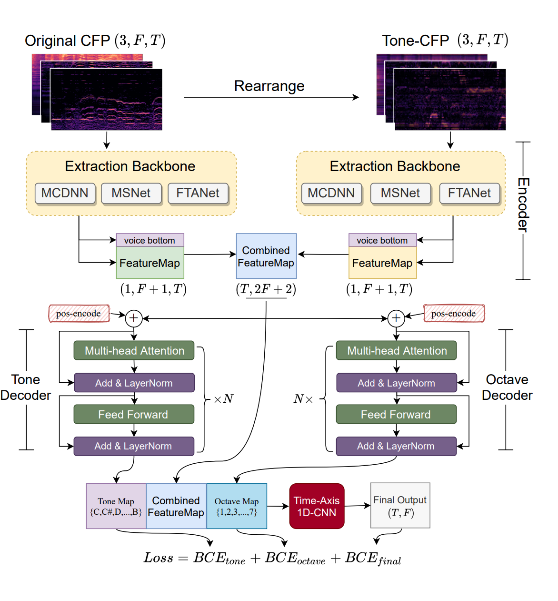
Related Work
TONet
Notes:
Add reference -> Backup slide

Slide 19
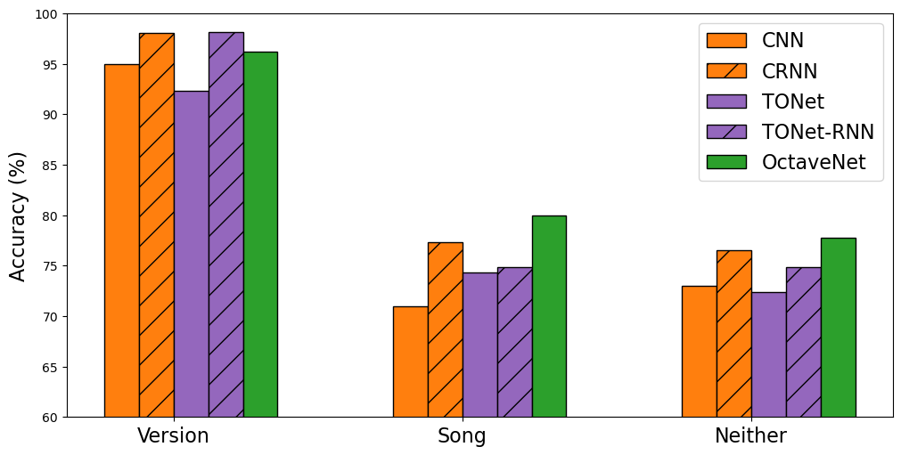
Results
Ablation studies
OctaveNet is also better than TONet (w/ or w/o RNN) on song/neither split
Chen et. al., ” TONet: Tone-Octave Network for Singing Melody Extraction from Polyphonic Music”, in ICASSP, 2020.

Slide 20
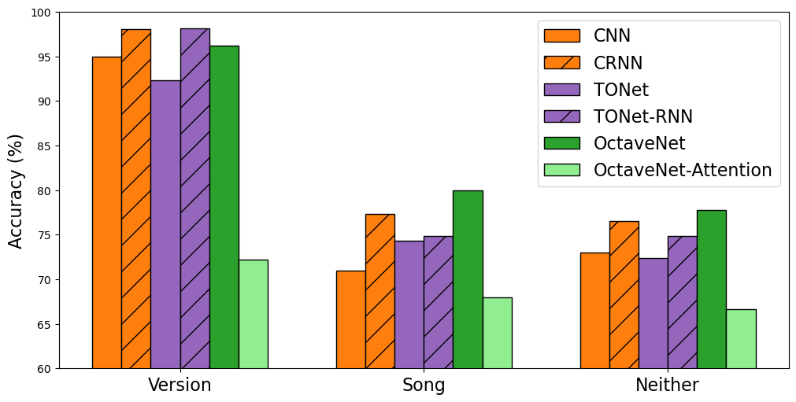
Results
Ablation studies
Self-attention does not work as well as RNN

Slide 21
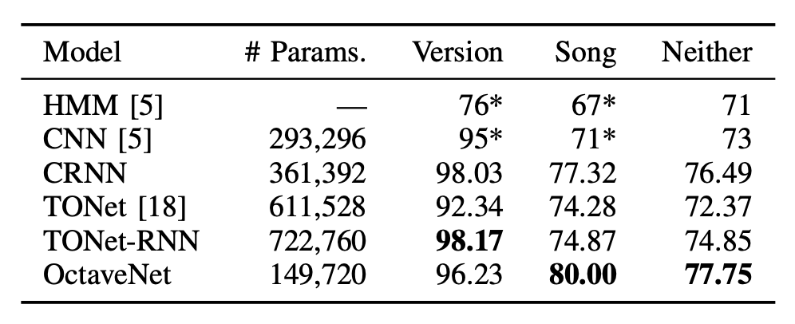
Results
Comparison with baselines & ablation studies
Less parameters
Similar or better results

Slide 22
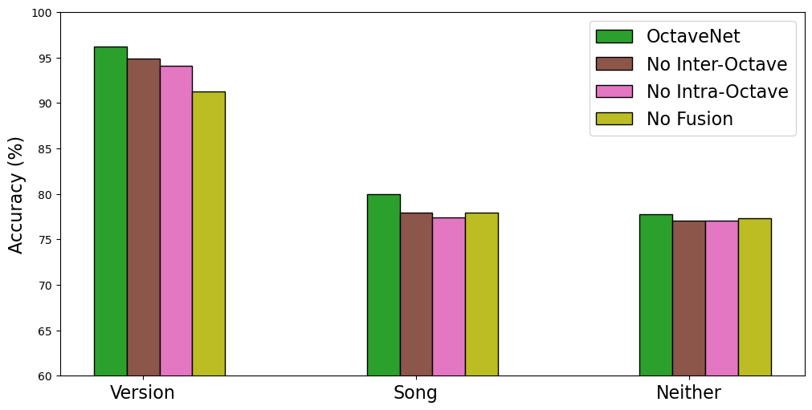
Results
Ablation studies
Removing any component leads to a performance decay
…Really? -> Performance are similar on the neither split!
Green (top)
Blue (bottom)

Slide 23
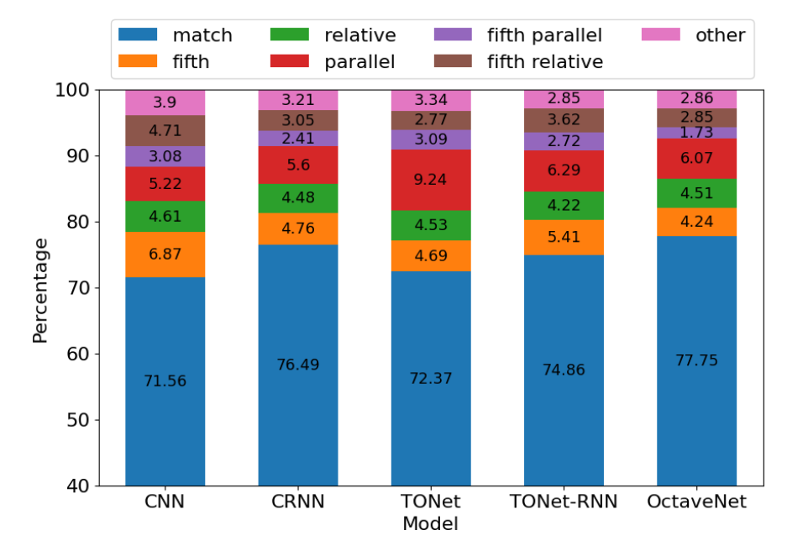
Results
Different types of errors
Notes:
Backup slide (Further findings)

Slide 24

Results
Case study: success
Notes:
Add animations and audio (potentially)

Slide 25
Results
Case study: failure
Notes:
A1/A2 just for reference / Remove cross-annotators

Slide 26


Conclusion
We propose OctaveNet, a musically inspired neural network for local key estimation.
With less parameters, it outperforms several baselines on the Schubert Winterreise dataset.
The domain knowledge in the CQT rearrangement and the recurrent components are two keys for the improvement.
Code (GitHub repo)
Computational Humanities
Personal Website
😜

